Slide 1
Cold War
Berlin Wall
SYMBOL
Rise and Fall

Slide 2
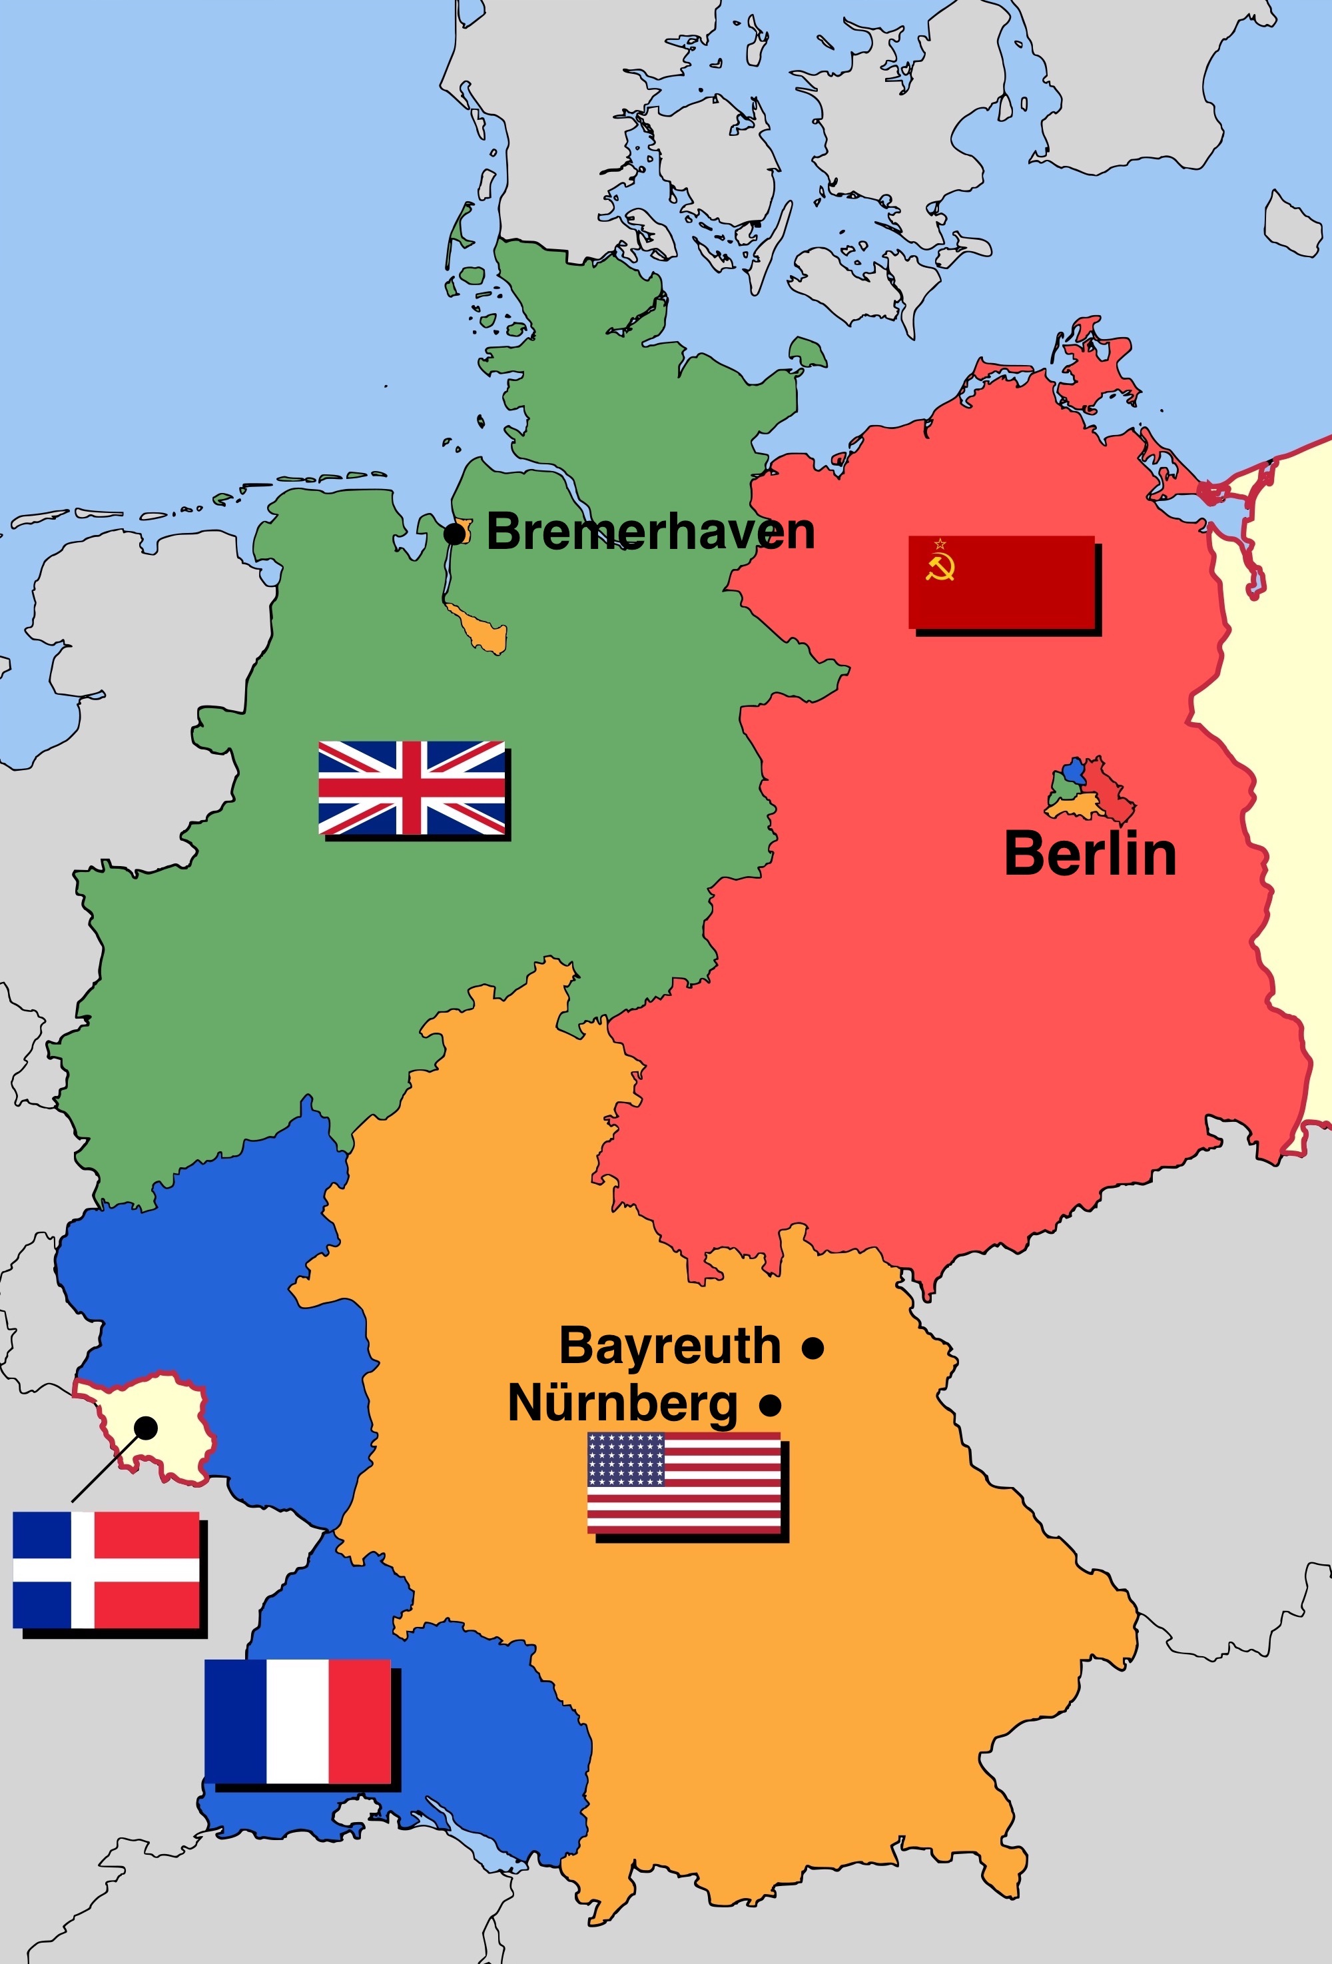
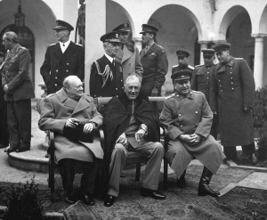
POST WAR
GERMANY
German Division
Berlin Division
Further Division
West Approach
Soviet Approach

Slide 3
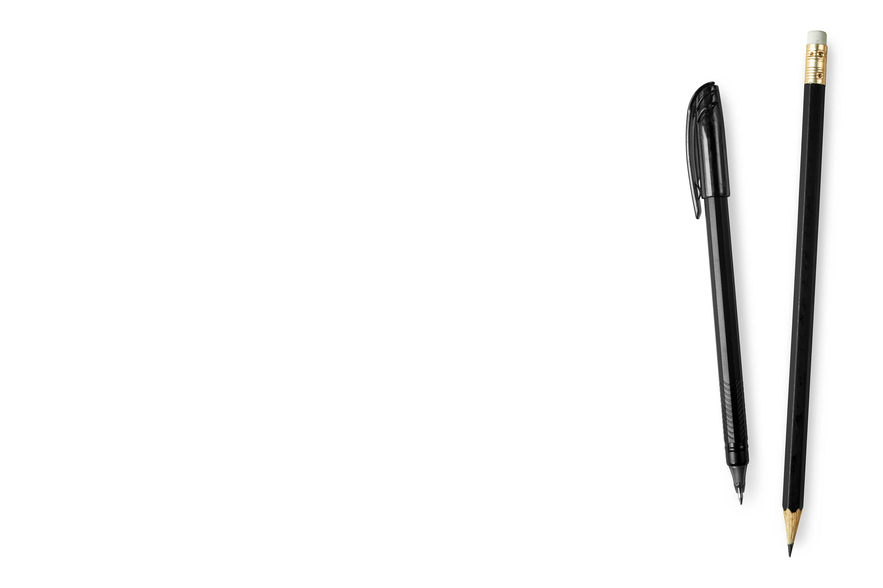
0|1
MIGRATION
20%
BOOM PEOPLE CHOSE CAPITALISM OVER COMMUNISM

Slide 4
Why would people
#01 Freedom
#02 Higher Pay
#03 More goods
Migrate
Suppression by Soviet Union and Stazi
Bigger salaries and better opportunities
Cool new Consumer Goods

Slide 5
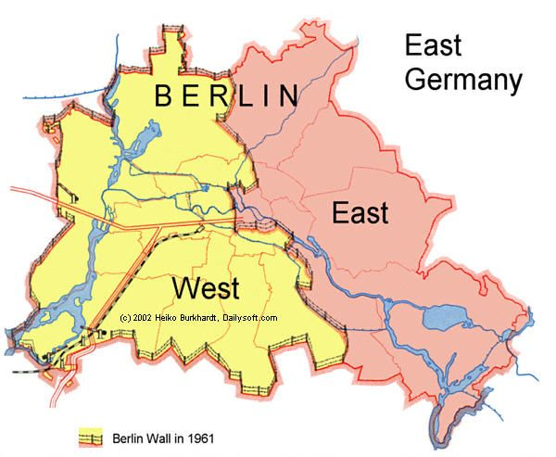
Construction of
Berlin Wall
Reasons:
Humiliation
Loss of important people
Increase of control
East German recognition Checkmate
Kruzchew build a wall
H = 3.6M, Landmines, Watchguard, Bunkers, Barb Wire, etc

Slide 6
Life during the
Berlin Wall
Tighter Suppression
Harder/Impossible to contact friends and family on other side
Which led to some trying to escape
5000 People escaped
138 Died Trying Escaping

Slide 7
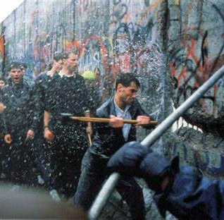
The Fall of
Berlin Wall
Liberalization Of Communism
Ease of Permits
Gorbachev

Slide 8
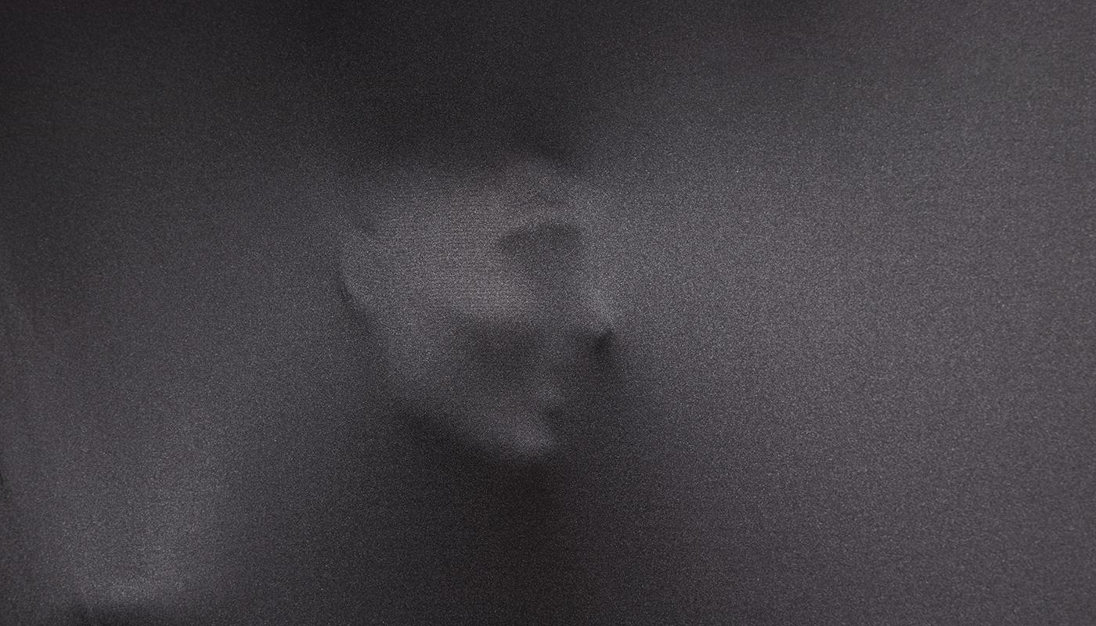
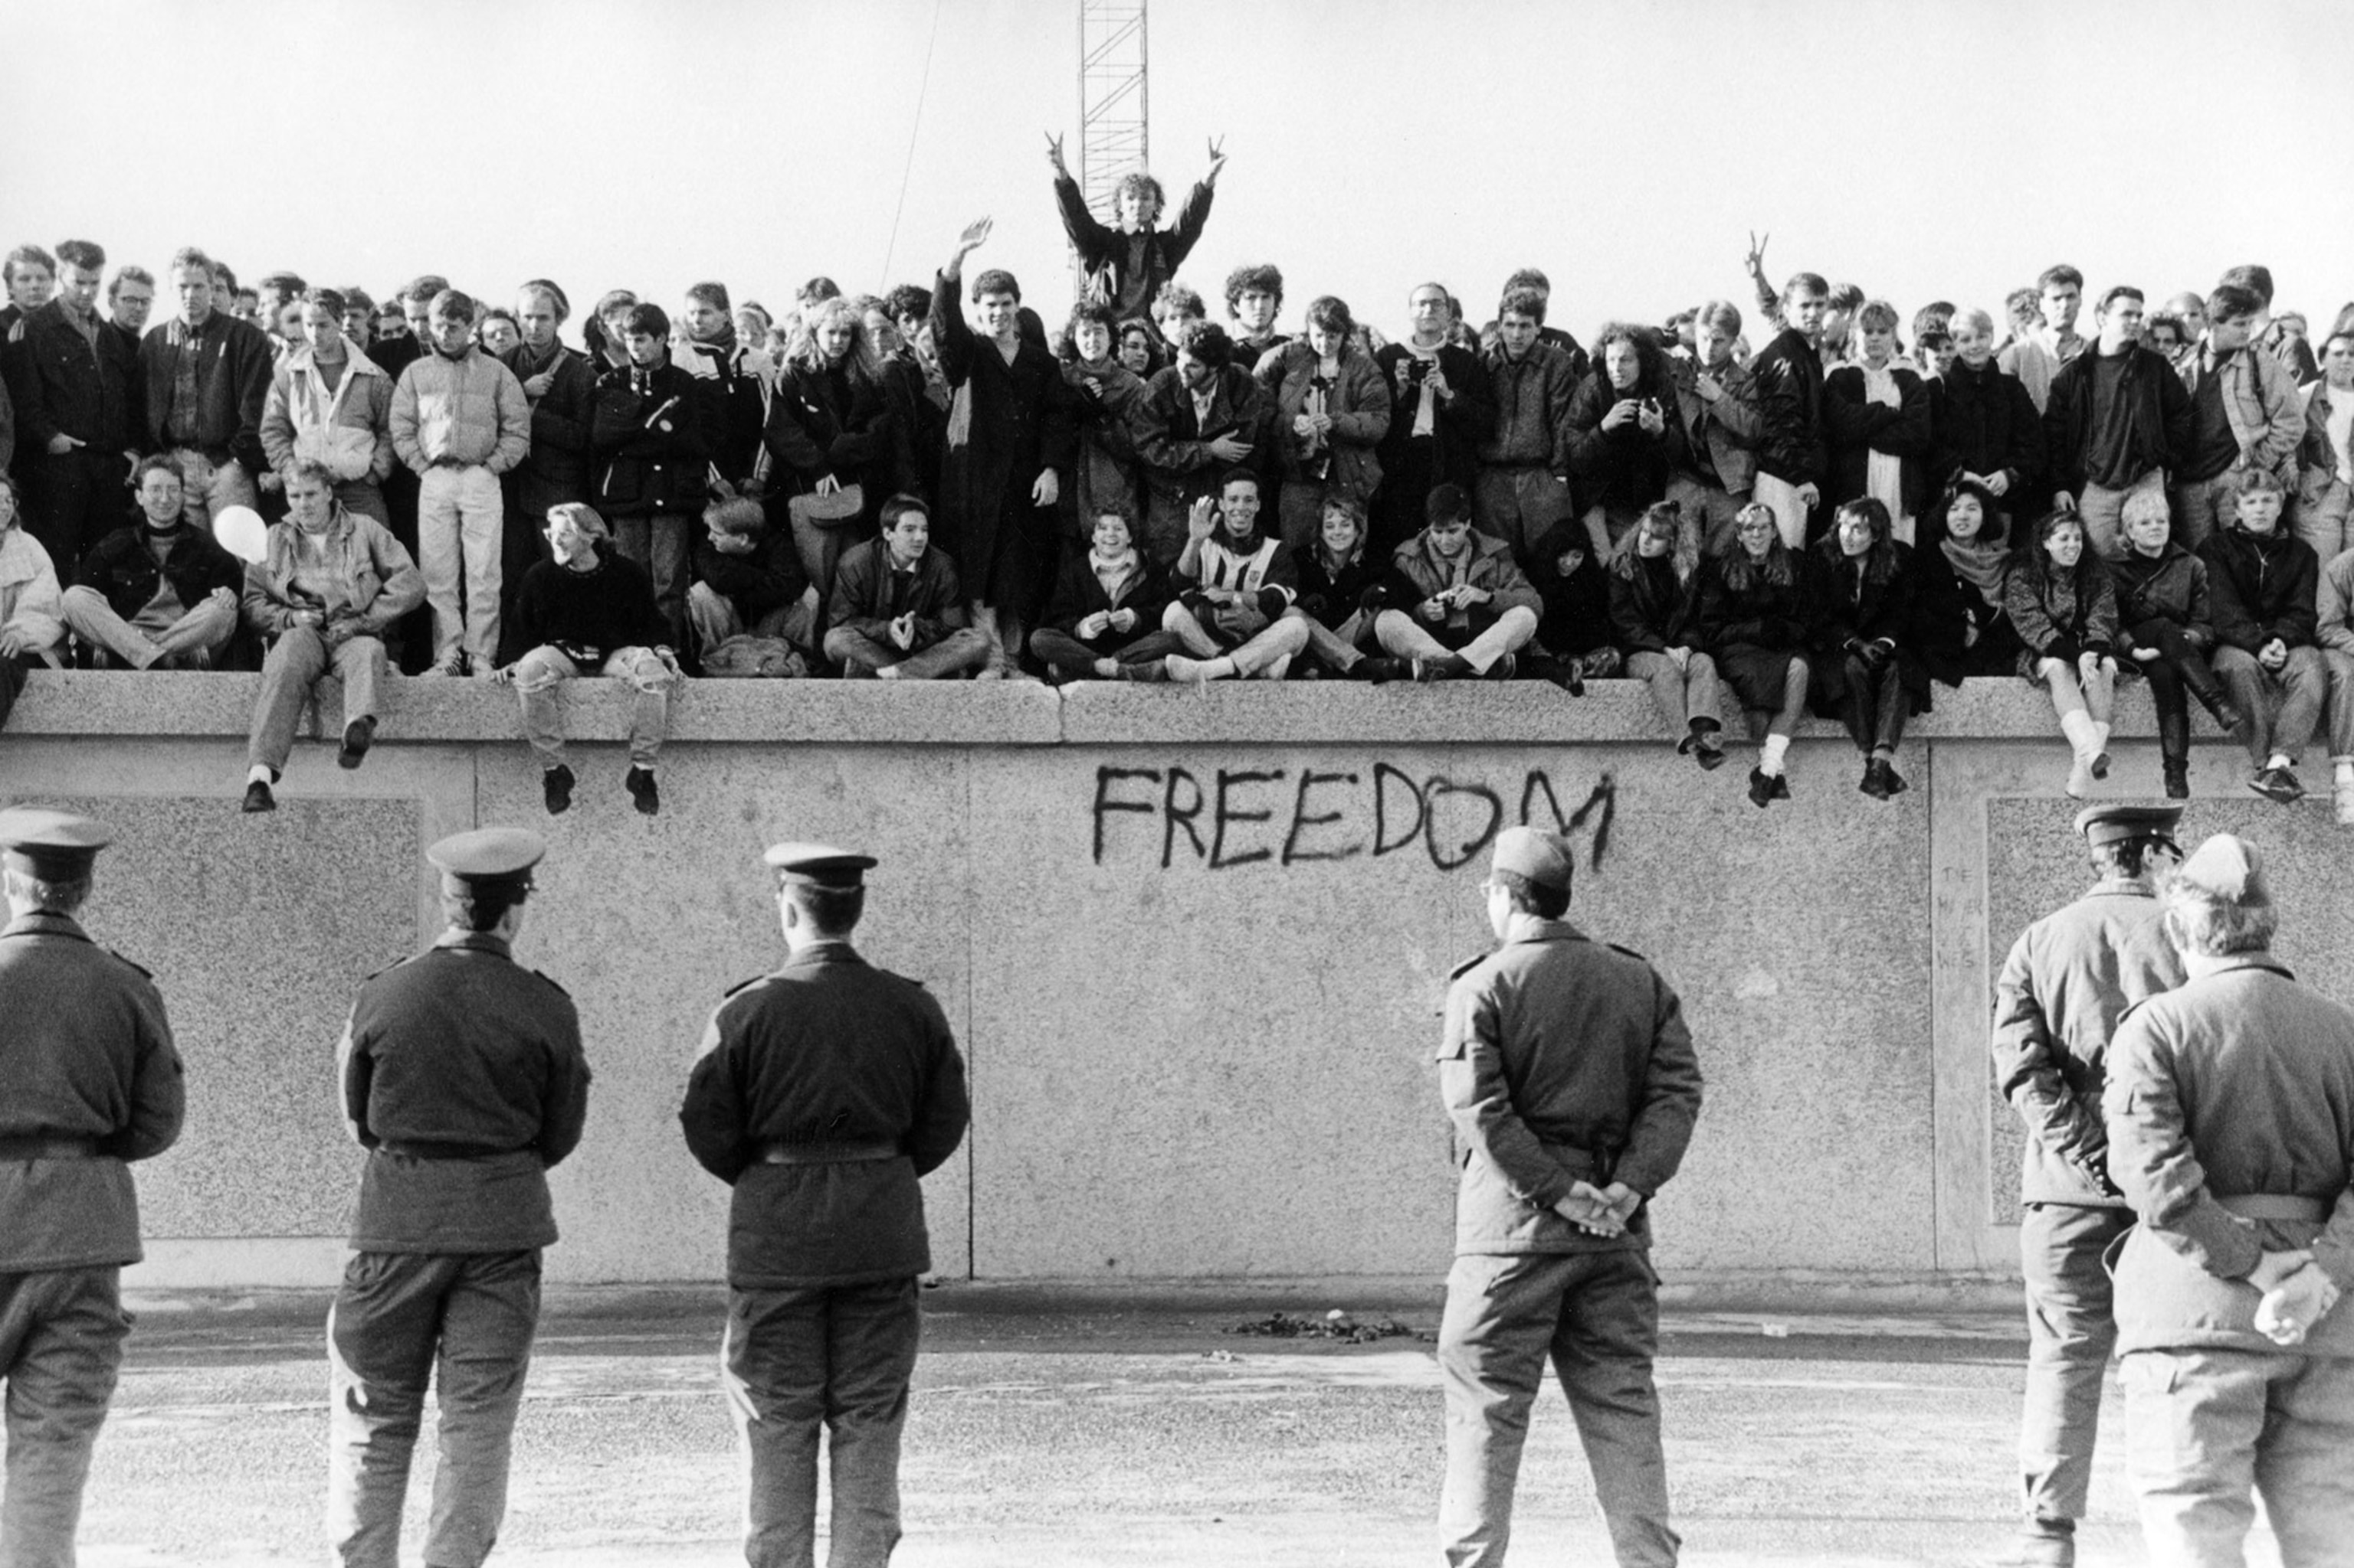
A PICTURE IS WORTH A THOUSAND
WORDS

Slide 9
MANY
THANKS!
Do you have any questions?
2:50
Awesome Video
USSR Bad, Stazi Bad, Nazi Bad
Fanta Good

